Slide 1
21CS1512 - Socially Relevant Mini Project
1
AI Health Advisor: An AI-Based Health And Nutrition Prediction System
Domain: Artificial Intelligence
Batch: C - 12
Team Members:
Nikhitha K V(2022PECCS227)
Nikitha R G(2022PECCS228)

Slide 2

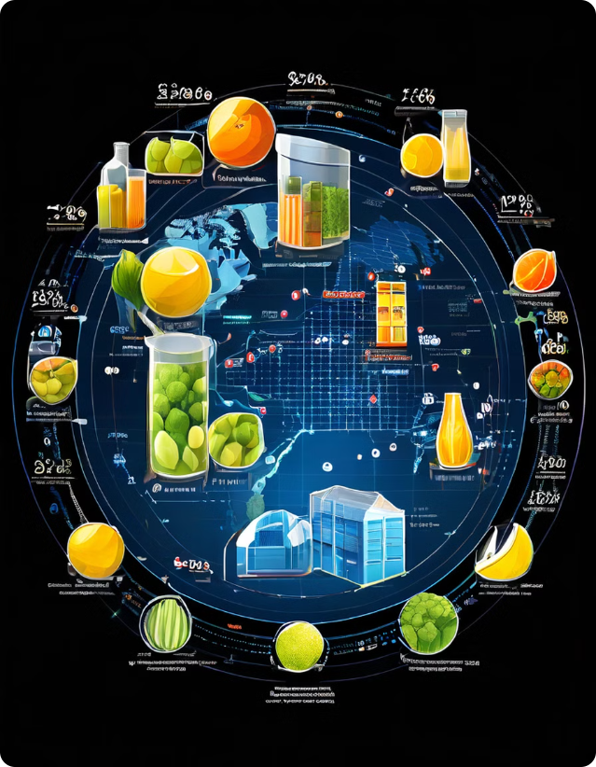
2
Abstract
The "AI Health Advisor" is an innovative application designed to enhance personal health management through the integration of predictive health analytics and personalized nutrition recommendations. Leveraging advanced machine learning algorithms and natural language processing, this application offers users accurate health predictions based on their symptoms, medical history, and lifestyle choices. Additionally, it provides tailored nutritional advice to help manage or prevent potential health conditions. By combining these elements into a seamless, user-friendly interface, the AI Health Advisor aims to promote better health and wellness through accessible, data-driven insights and personalized advice. This project fills a gap in the market by offering a holistic health management tool that addresses both predictive health and nutrition in a single platform.

Slide 3
Exsiting System
3
Health Prediction Systems:
Current Examples: Existing applications like Ada and Your.MD offer health prediction services by analyzing user-reported symptoms and medical history. These apps use basic algorithms to provide probable diagnoses and suggest next steps.
Limitations:
Lack of Integration: These systems typically focus only on health predictions and do not integrate nutrition analysis.
Limited Personalization: Current systems may not fully consider the comprehensive lifestyle and dietary habits of users, leading to less accurate predictions.
User Experience: The interfaces of many existing apps can be clunky and not user-friendly, affecting user engagement and satisfaction.
Nutrition Analysis Systems:
Current Examples: Apps like MyFitnessPal and Cronometer provide users with nutrition analysis based on their dietary inputs, tracking macronutrients, vitamins, and other nutritional information.
Limitations:
Separate Functionality: These systems focus solely on nutrition analysis and do not integrate health prediction features.
Generic Recommendations: Recommendations are often based on general guidelines and may not be personalized according to individual health conditions or needs.

Slide 4
4
Proposed System
AI Health Advisor:
Integrated Approach: Combines predictive health analytics with personalized nutrition recommendations in a single, comprehensive application.
User-Friendly Interface: Designed with an intuitive interface for both web and mobile platforms, ensuring easy navigation and user engagement.
Personalized Predictions: Utilizes advanced machine learning algorithms to provide tailored health predictions based on comprehensive user profiles, including symptoms, medical history, and lifestyle choices.
Detailed Nutrition Analysis: Offers customized dietary advice to help manage or prevent potential health conditions, taking into account the user’s health status and preferences.
Key Features:
Symptom Checker with NLP
Health prediction
Nutrition Prediction
Disease Prediction
3​

Slide 5
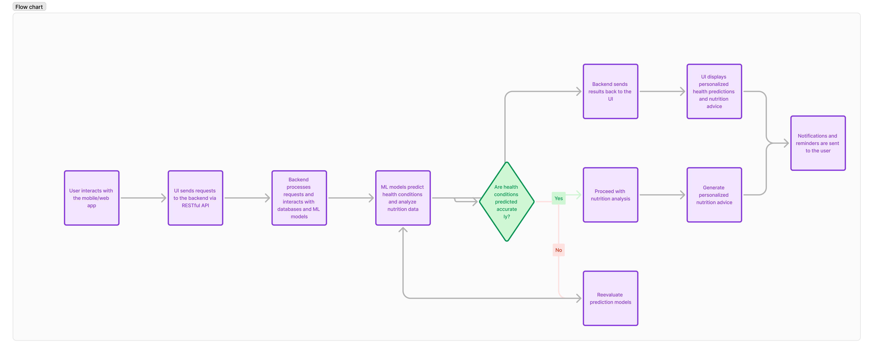
5
Architecture diagram

Slide 6
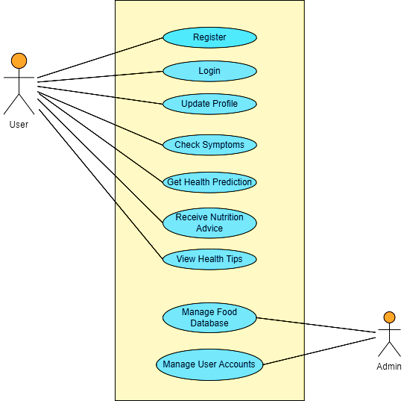
UML diagram
6
Use Case Diagram

Slide 7
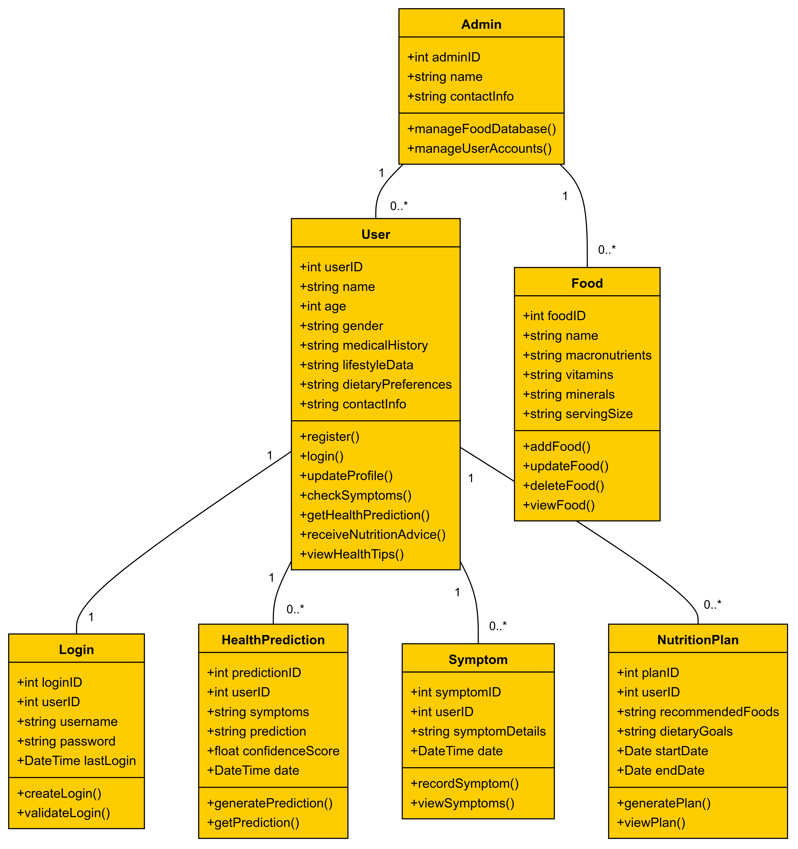
UML diagram
7
Class Diagram

Slide 8
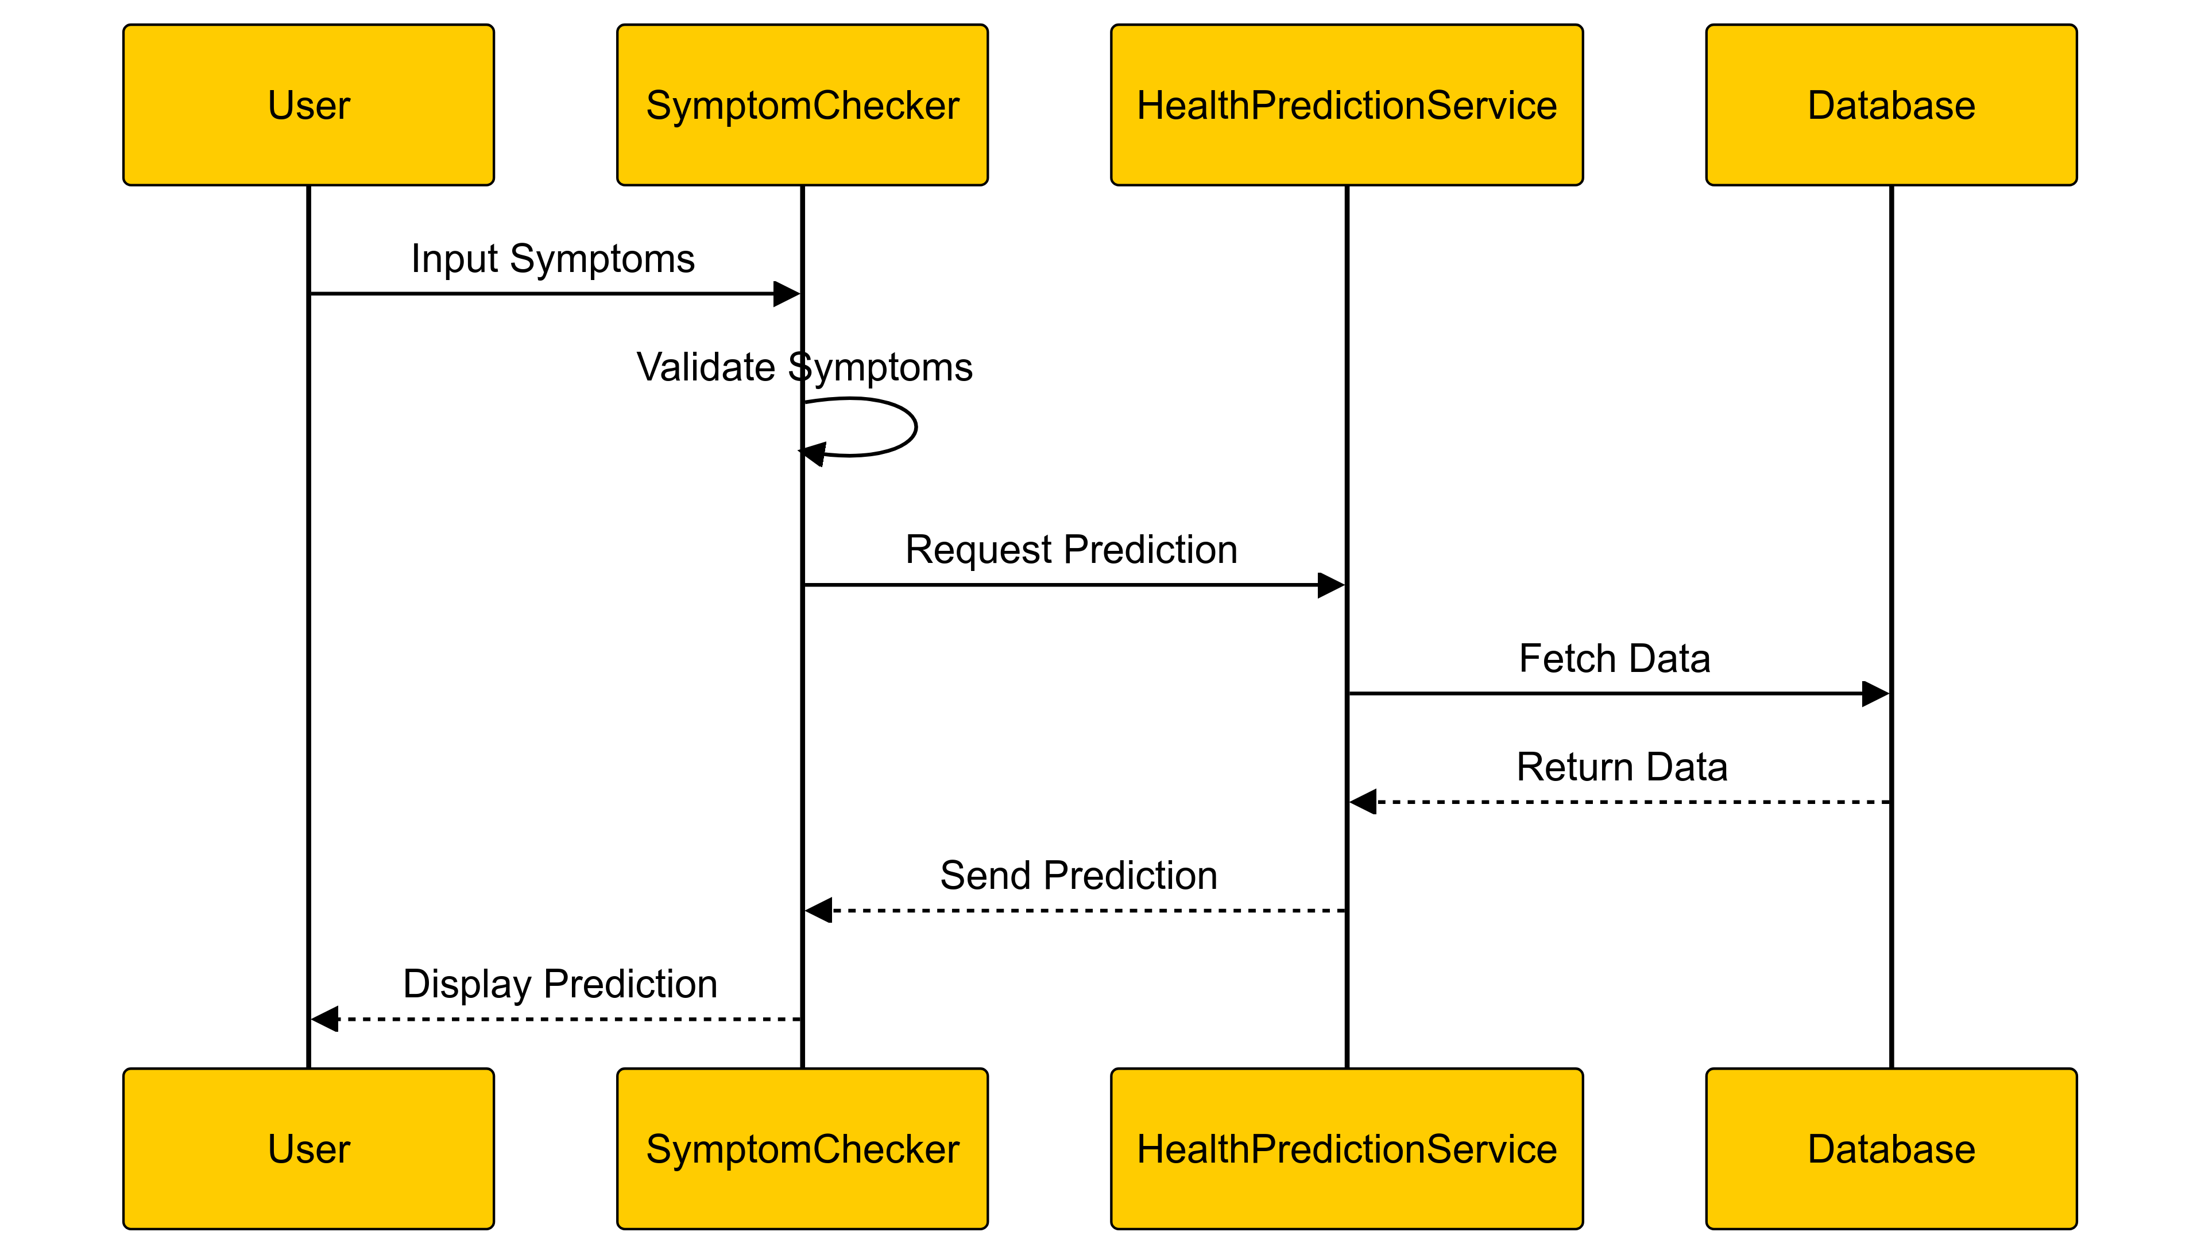
UML diagram
8
Sequence Diagram

Slide 9
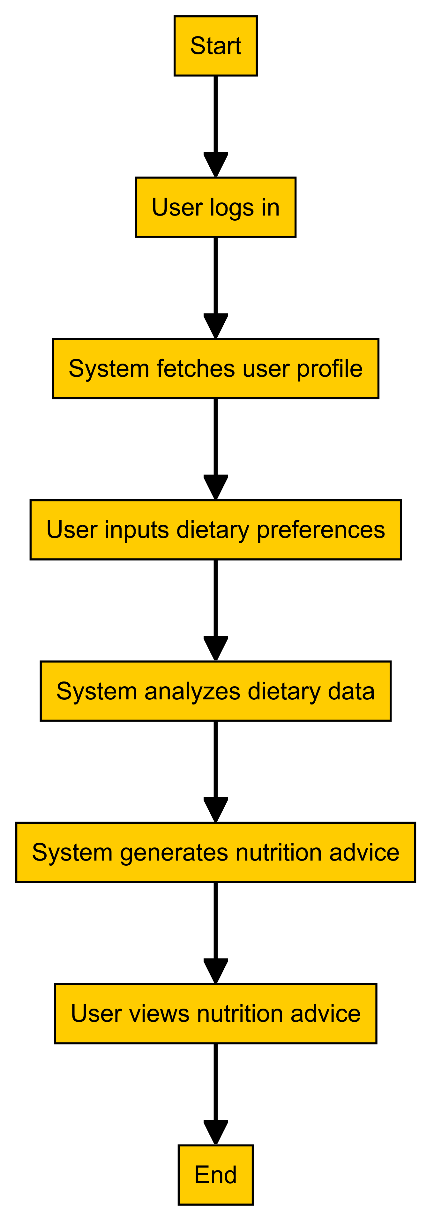
UML diagram
9
Activity Diagram

Slide 10
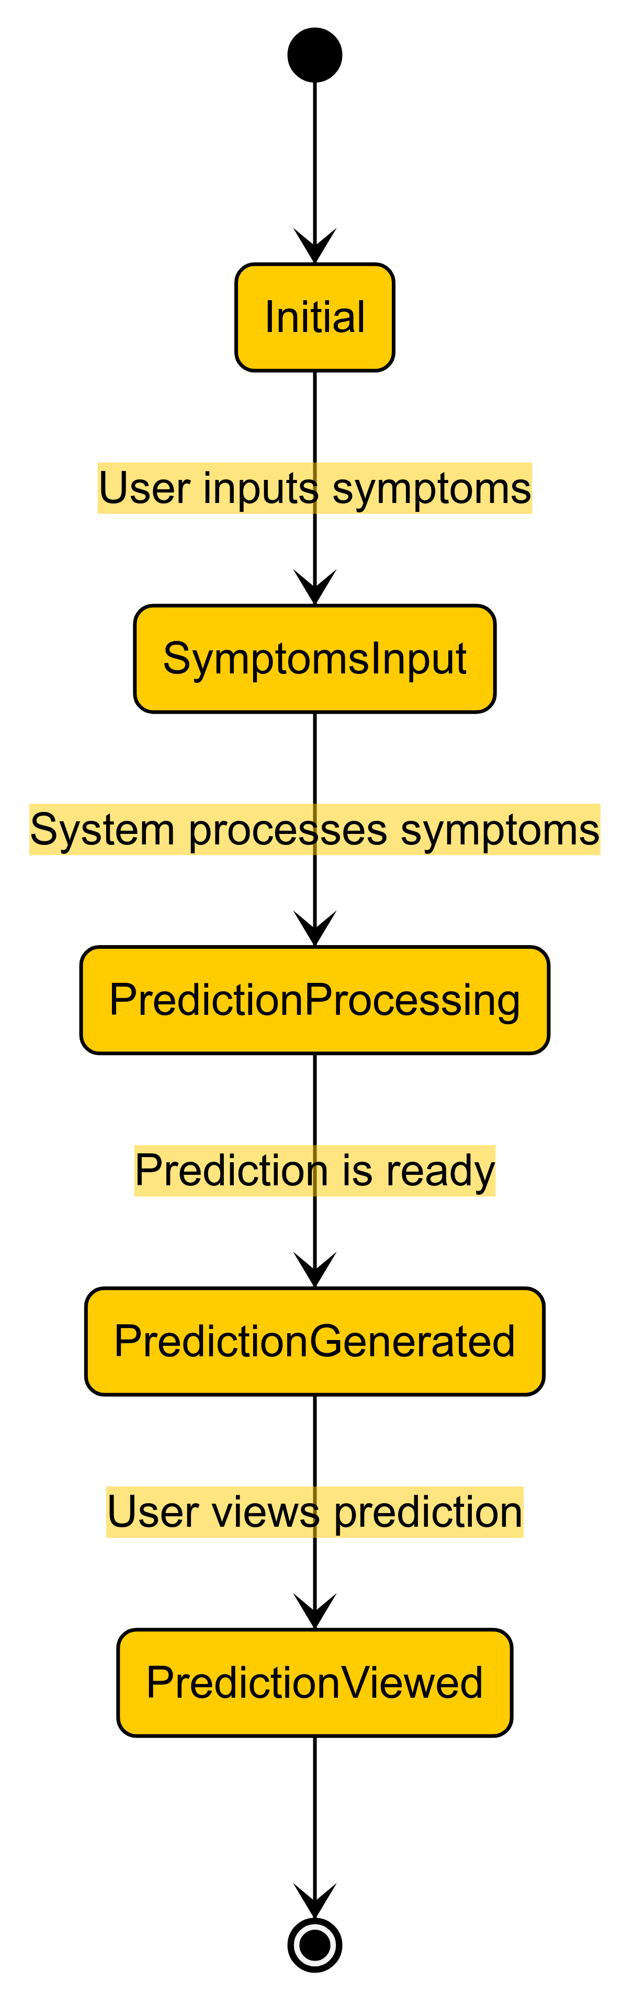
UML diagram
10
State Diagram

Slide 11
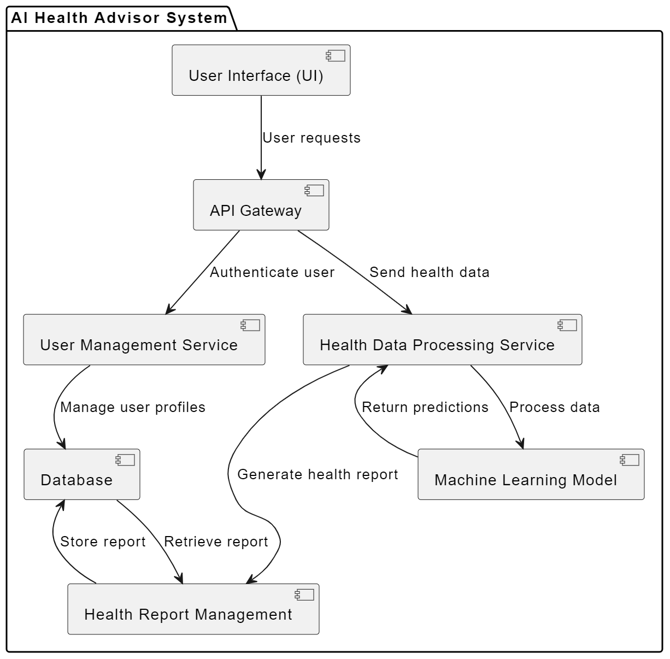
UML diagram
11
Component Diagram

Slide 12
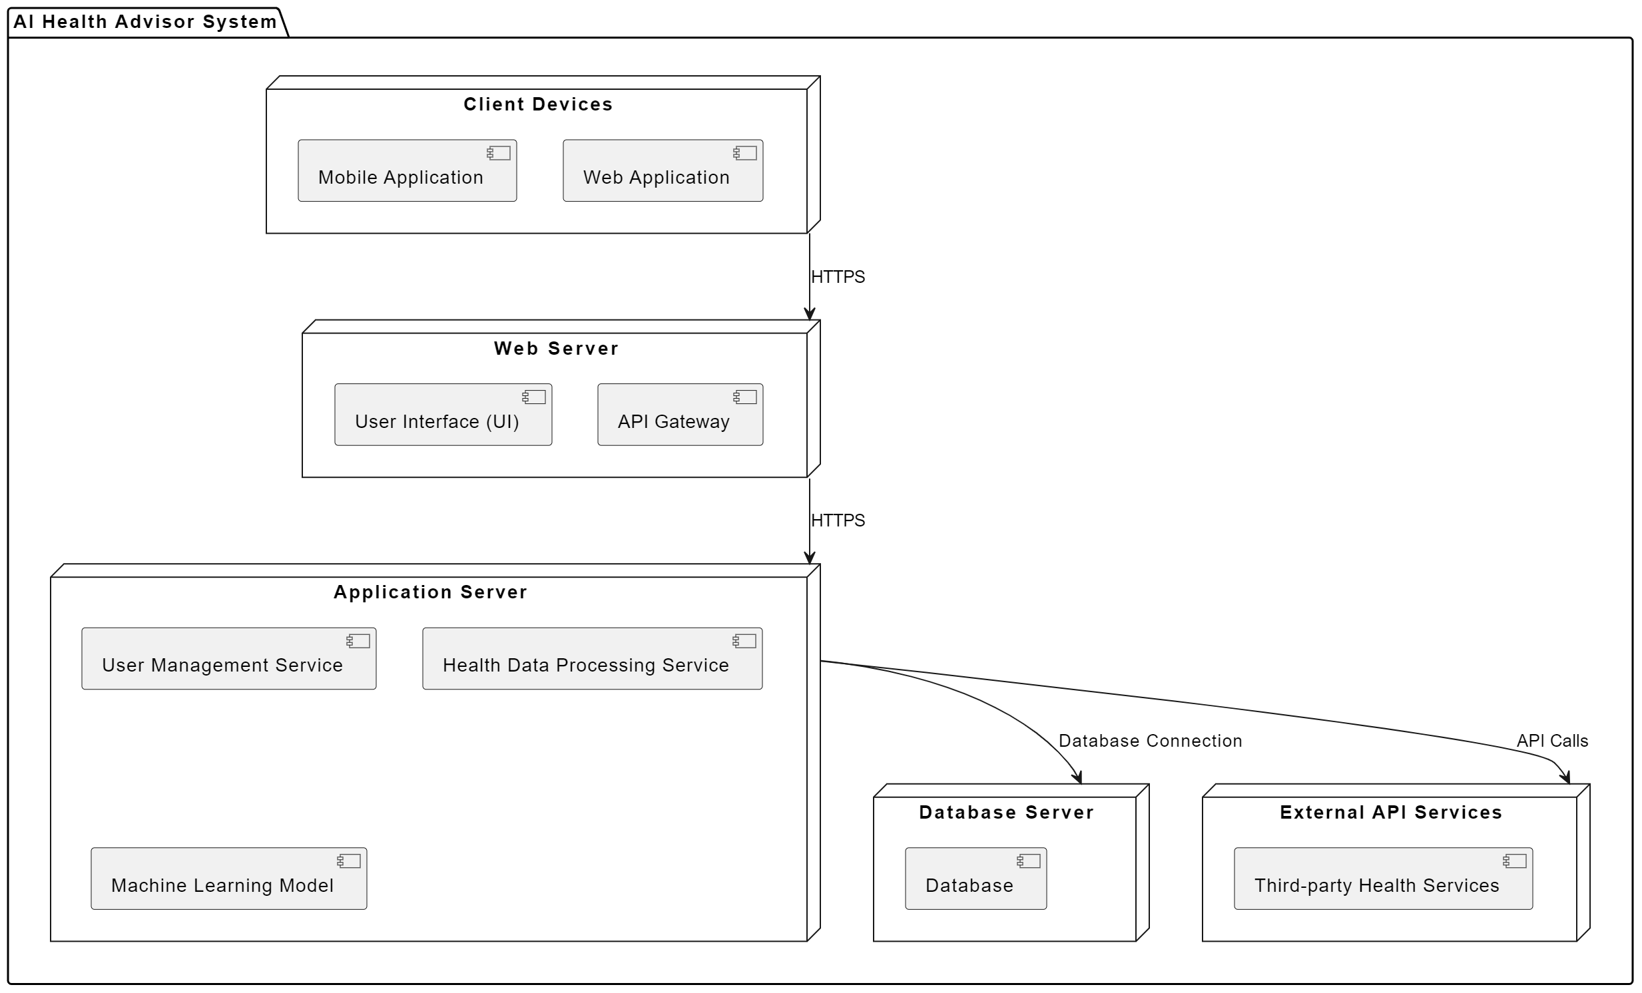
UML diagram
12
Deployment Diagram

Slide 13
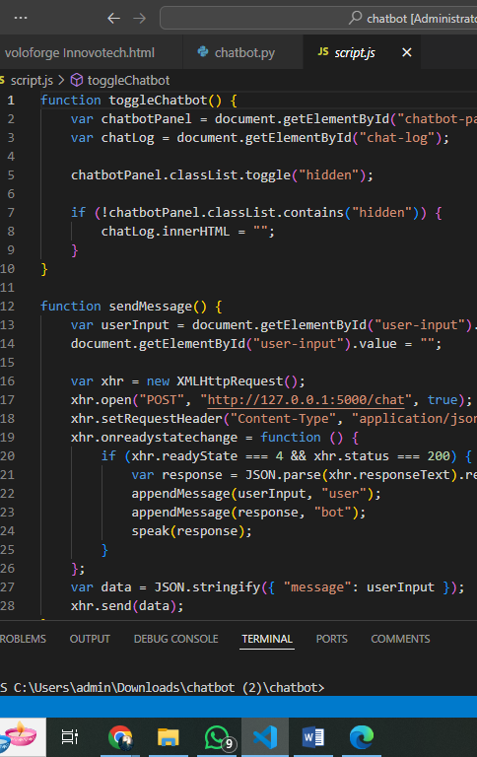
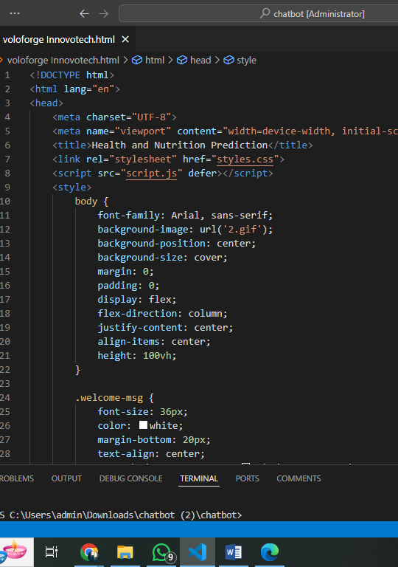
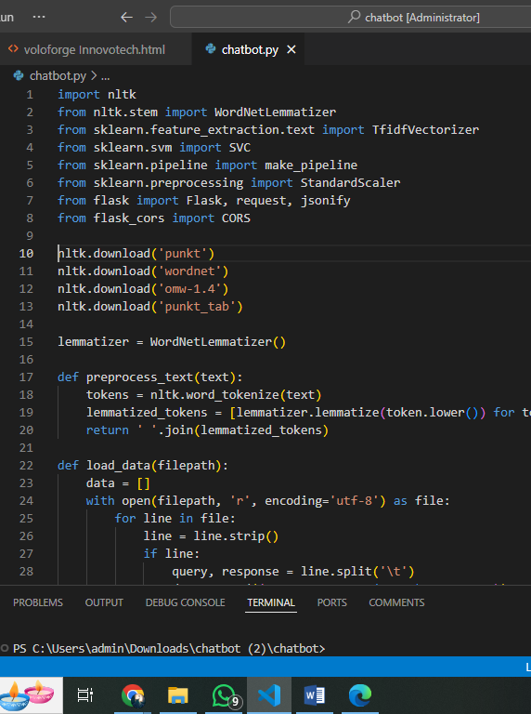
13
System Implementation

Slide 14
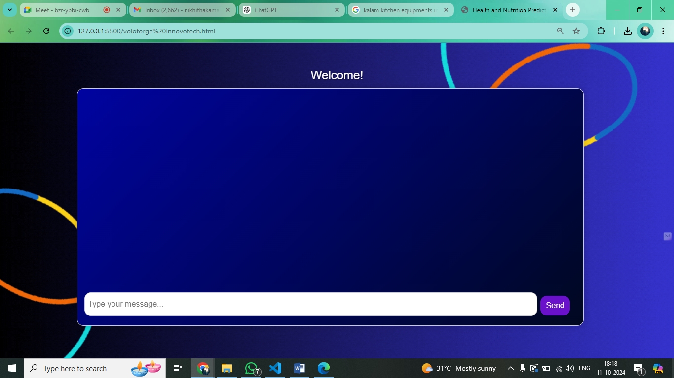
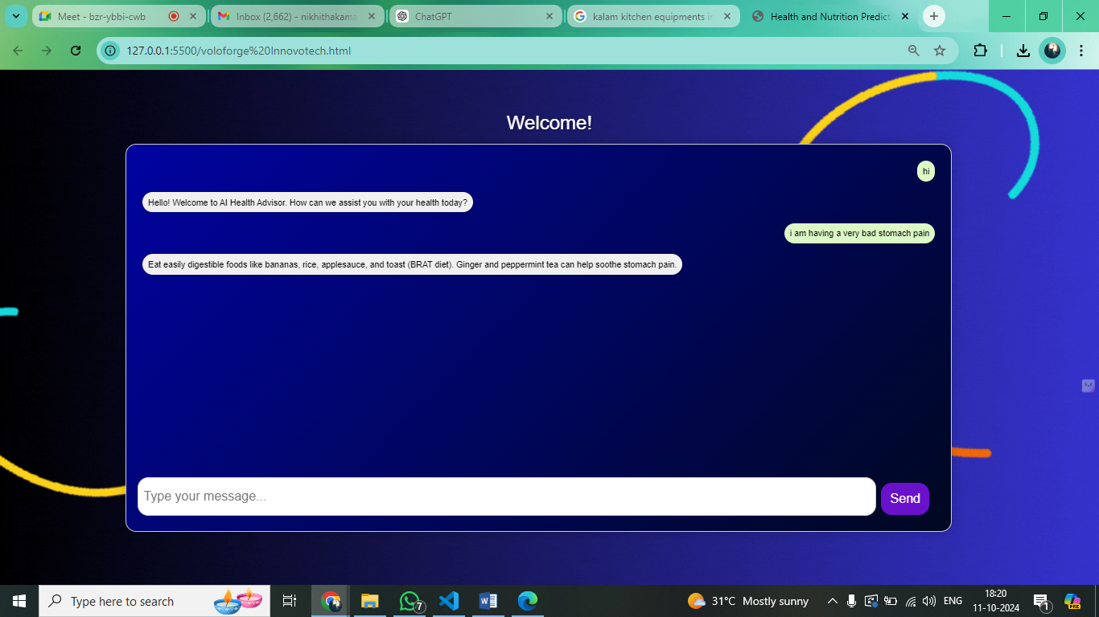
Output Screenshots
14

Slide 15
15
Future Enhancements
Personalized diet and exercise recommendations based on health goals and lifestyle
Integration with wearable devices for real-time data collection (e.g., heart rate, activity)
Machine learning for continuous improvement and adaptive predictions
Multi-language support for a global audience
Mental health monitoring and predictive analysis for holistic guidance
Integration with medical databases for up-to-date health guidelines
Development of a mobile app for easier access and health tracking on the go
Doctor consultation module for medical advice based on predictions

Slide 16

16

